Slide 1




Slide 2
Commitment to those we serve
Our values
  Put the customer first
Local engagement
  Employees live and work in communities we serve
  Local decision making
Commitment to veterans
  Veterans, reservists and their spouses represent over 1 out of 10 Frontier employees (approximately 13%)
  Member of The Military Spouse Employment Partnership, the 100,000 Jobs Mission, The Employer Partnership of the Armed Forces, Honor and Remember, and Joining Forces

Slide 3
Quick Facts
Leading provider of communications services in urban, suburban and rural America
States Served: 29
Employees: 23K (approx.)
Revenue: $9.0B (approx.)
Regional headquarters: Rochester, NY
Corporate headquarters: Norwalk, CT

Slide 4
Current Video Service Areas
Fiber to home (FTTH)
  Suburban Seattle, WA; Suburban Portland, OR; Southern California (from Santa Barbara to the Palm Springs area); Suburban Dallas, TX; Fort Wayne, IN and Tampa, FL
Fiber to the node and fiber/copper to the home
  Hudson Valley; Connecticut; South Metro Twin Cities, MN; South Carolina; Ohio; and Bloomington/Normal, Illinois

Slide 5
Vantage TV Overview
Powered by Ericsson’s Mediaroom software platform
  #1 IPTV platform with over 16.4M subscriber households and 32.0M connected devices
  Operates over IP enabled networks (xDSL, FTTP/FTTN, etc.)
Core Product Features
  Secure delivery of SD (standard definition), HD (high definition) and 4K/UHD (ultra high definition)
  Superior HD, SD, UHD picture quality
  WiFi enabled set top boxes allowing customers to place TVs wherever they want in their home
  Live TV broadcast with instant channel change allowing super-fast navigation through our interactive programming guide
  Video on demand library
  Total Home DVR records up to six shows at once and lets customers pause, rewind and play back live TV and store over 370 hours of HD programming (we provide up to 1 Terabyte of on premise storage)
  Next Generation EPG (Electronic Program Guide) and enhanced search functionality with rich, new poster-art driven experience that allows consumers to easily discover and consume content on their terms
  Integrated interactive applications include Social TV (access to Twitter and Facebook), Weather, Interactive Workout, Home Shopping Network and interactive games.

Slide 6
Equipment
One DVR, one experience, any receiver.

Slide 7
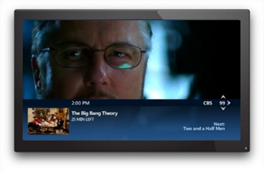

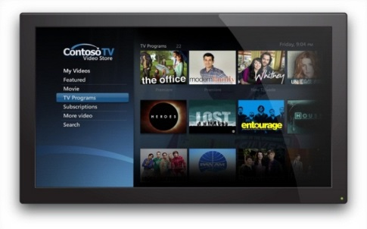
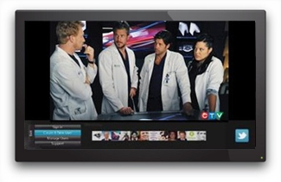
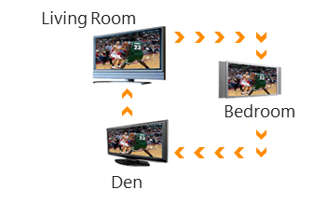
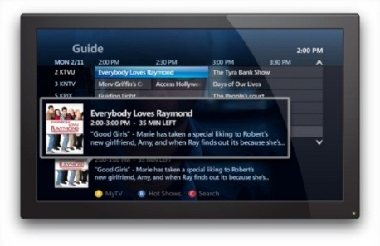

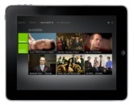
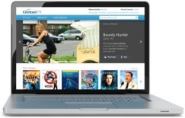


Vantage TV Experiences
Instant Channel Change
Multiview
Video on Demand
Interactive Applications
Change channels in the blink
of an eye (Live TV)
See up to six different screens
at one time on your
television
Find movies and videos to
watch – right now
Blending Broadcast and
Internet content
Whole Home DVR
Visual Guide
Companion Services
Wireless STB
Record on one DVR and watch on any TV in the house
Unique and Intuitive
Program your DVR from your PC, smartphone or tablet
Freedom to watch your TV anywhere

Slide 8
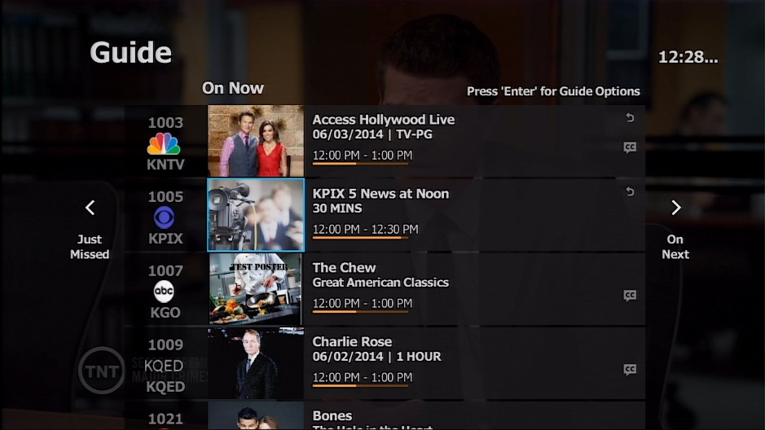
New Visual Guides
Discover more with a visual, full screen guide. Easy access to what is on now, just missed and on next.
Enhance User Experience with rich visual and at-a-glance layout.

Slide 9
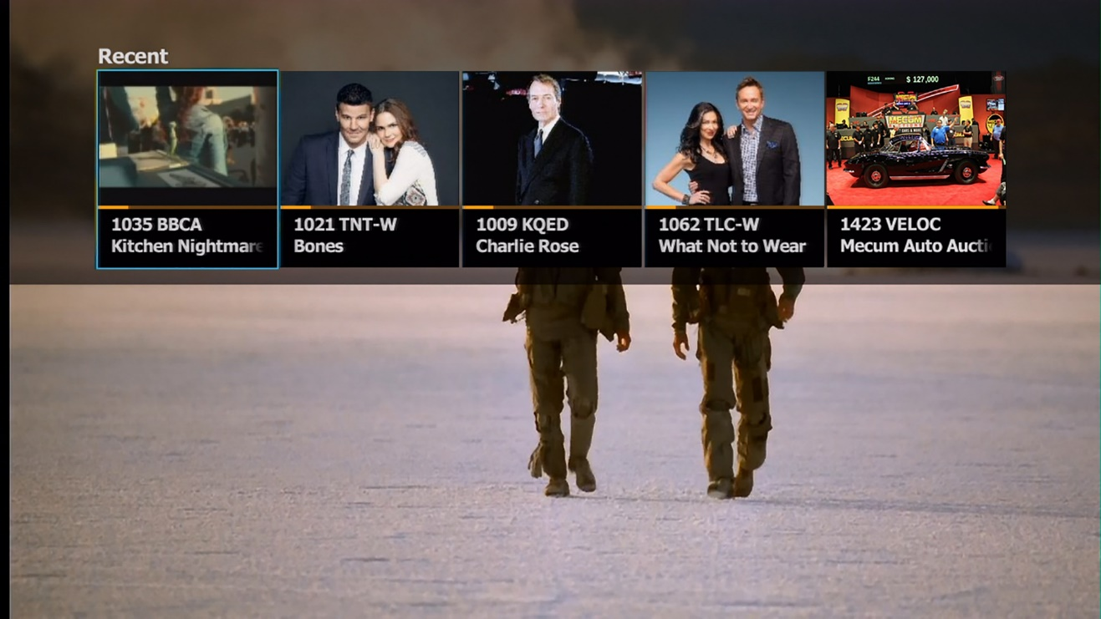
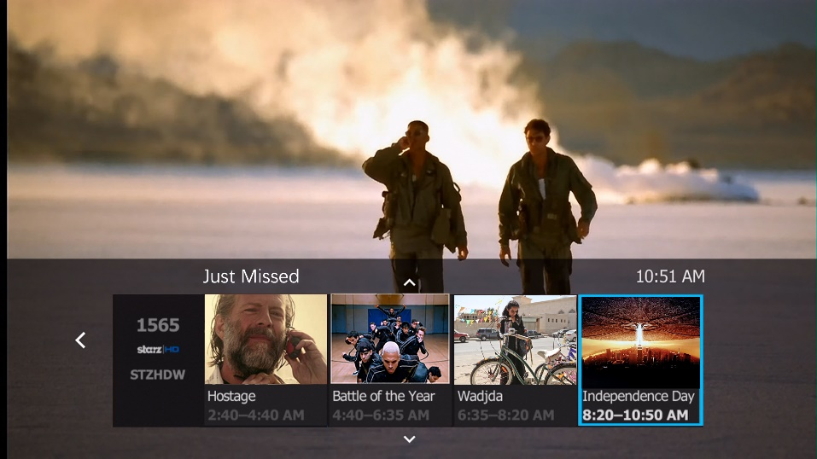
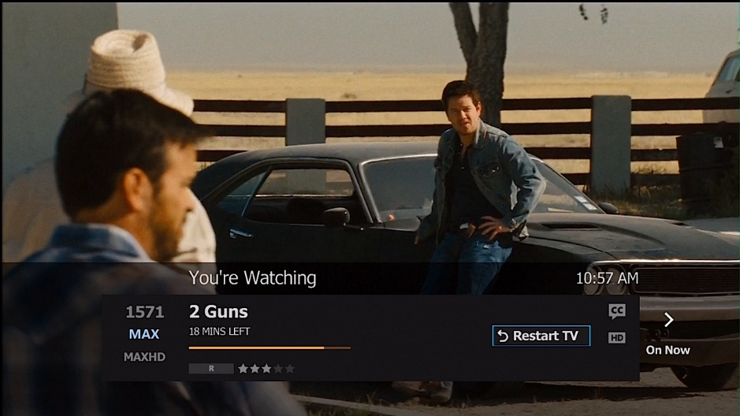
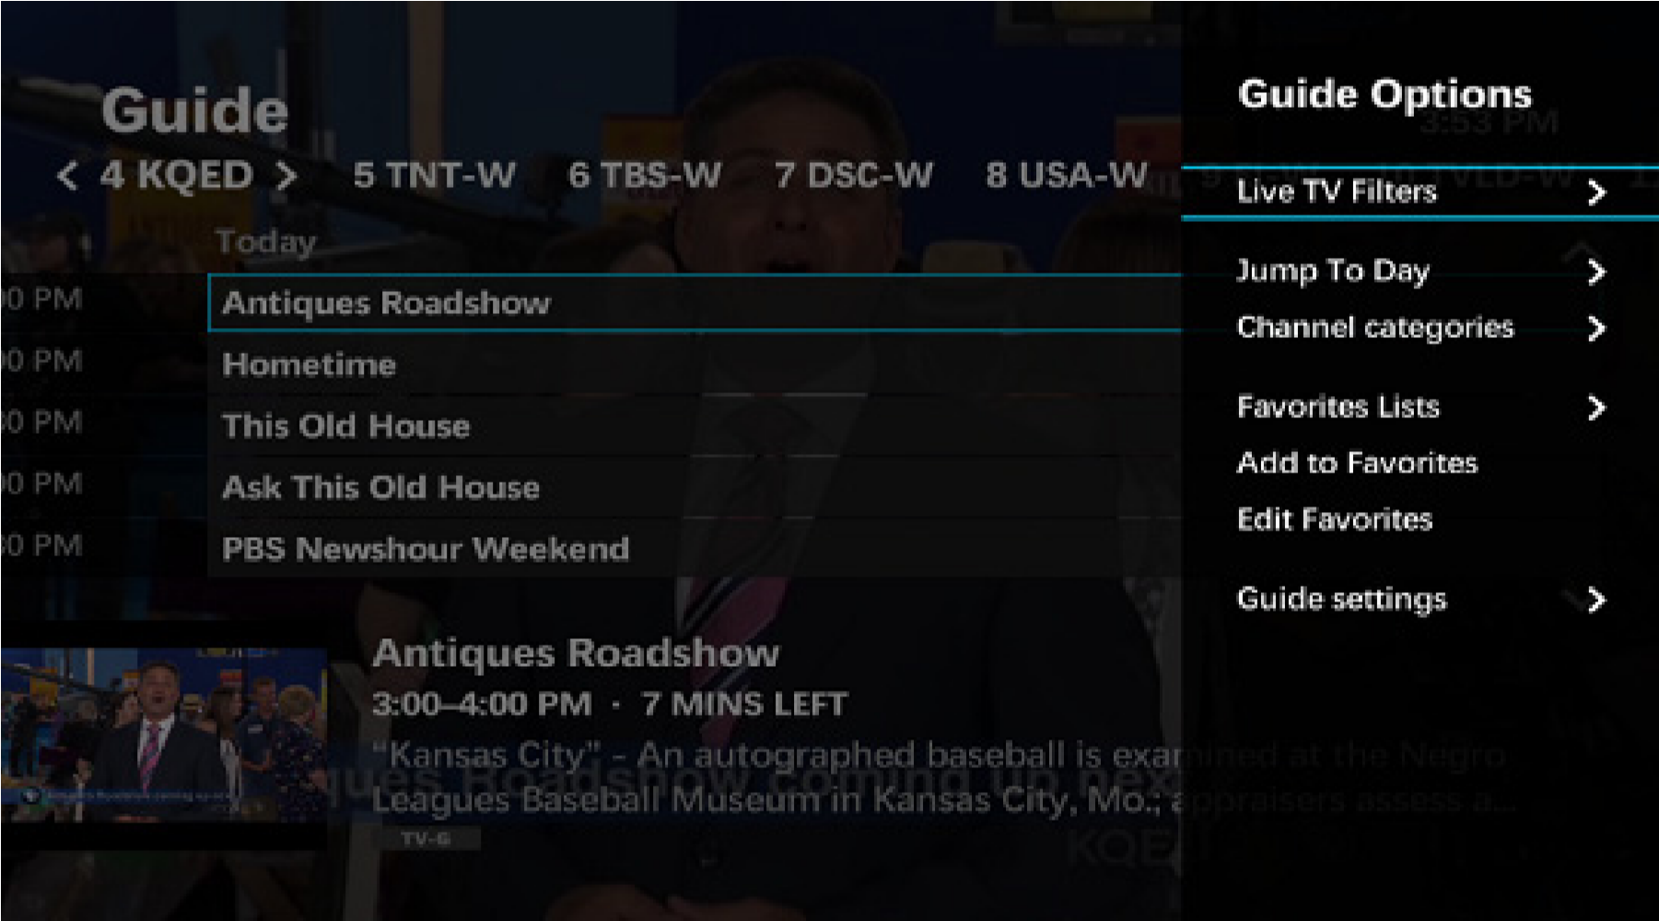
Channel Peeks
Enhanced browsing & uninterrupted viewing experience.
Easy way to preview other currently airing programs, PPV, SVOD.
Make it easier to find and enjoy content.

Slide 10
Unified Search
Fast, easy way to find what programs you are looking for.
Consolidated search results from all viewing options (VOD, DVR, Live TV Listings, OTT sources).

Slide 11
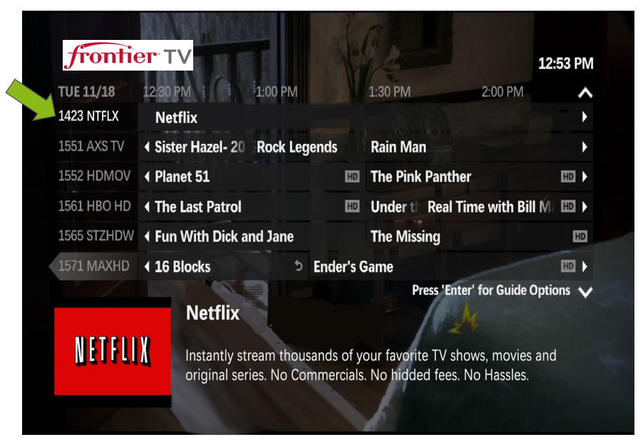
Over The Top (OTT) Content via Advantage TV User Interface (UI)
Vantage TV as a “one-stop” content shop – access Netflix/Amazon Prime content through our UI.

Slide 12
What this means to your community…
Residents and businesses will have access to:
  Next generation video experience
  Competitively priced alternative to cable provider
No inconvenience to the general public/constituents
  Will utilize existing facilities in public rights-of-way
  Network augmentation and upgrades will generally occur in enclosed cabinets and buildings
Increased franchise fee revenue and public, educational, governmental channel (PEG) fee revenue

Slide 13
Next Steps
Public hearing
Town approves franchise
Frontier files an application with the NY Public Service Commission for a Certificate of Confirmation of the Franchise
NY PSC issues Certificate
Frontier offers video service

Slide 14
We look forward to bringing competition and choice with an innovative video offering from Frontier Communications to the residents and businesses in the Town of Chester.

